Slide 1
Guardianship ”All you need to know.”
By: Barbara Stone, MPA
Registered Professional Guardian
PCMS FOR THE ELDERLY IN FLORIDA LLC.

Slide 2
Disclaimer
The following information provided is not intended as legal advice, legal advice can only be provided by a licensed attorney, licensed in the State of Florida.

Slide 3
Definition of Guardian
A guardian is defined as a person who looks after and is legally responsible for someone who is unable to manage their own affairs, especially an incompetent or disabled person or a child whose parents have died.
A guardian is someone who has been legally appointed to take charge of the affairs of another person, for example a child or someone who is mentally ill.

Slide 4
What guardians’ encounter on their cases
When a guardian is appointed by the court, the guardian has to visit the ward at their home, if they are living at home. On most guardianship cases that involve neglect by the individual themselves, the guardian will usually go into a home that is in deplorable living conditions.
The next slide will how an example of what most guardian’s run into when they are appointed on a case.

Slide 5
What guardian’s encounter on their cases continued…

Slide 6
Guardianship Law in Florida: Florida Statute 744
Florida Statute Chapter 744 governs Guardianship law in the State of Florida.
Types of Guardians:
Family Guardian;
Professional Guardian;
Public Guardian;
Guardian Advocate: Guardian advocate is under Florida Statute 393.12 not Statute 744

Slide 7
Legal Proceeding to Determine Incapacity
The following is a process in initiating an incapacity proceeding:
A petitioner files a Petition to Determine Incapacity in the mental health file along with a Petition for Appointment of Guardian. These forms have to be filed at the same time.
The court appoints a court appointed attorney a/k/a an attorney Elisor to represent the interest of the alleged incapacitated in the incapacity proceeding.
The court also appoints three examining committee members to evaluate the alleged incapacitated, prior to the hearing to determine incapacity and have their evaluations filed with the court.

Slide 8
Public and Professional Guardians
All guardian’s whether public or professional are overseen by the Office of the Public and Professional Guardian OPPG.
OPPG has complete oversight on all guardians and also approves the standards of practice for public and professional guardians.
The office of OPPG is held under the auspice of the Department of Elder Affairs.
www.elderaffairs.state.fl.us

Slide 9
Family Guardians
When an individual has been adjudicated incapacitated by the court, the court will firstly show preference to Family Guardians. However, if the proposed family guardian does not qualify under the statute to be appointed as the guardian for their family member, then the court will appoint a professional guardian if the alleged incapacitated has assets or the public guardian, if the alleged incapacitated is indigent.

Slide 10
Guardian Advocate
Guardian advocates are appointed by the court on cases where the individuals possess disabilities. These individuals reached the age of majority and their parents no longer have the legal authority to consent to their medical treatment.
Family members can be appointed as guardian advocate for their family member once they reach the age of majority which in legal terms is known as sui juris. Professional guardians, are also appointed as guardian advocate. The main difference between guardian advocate and guardian is that guardian advocate does not adjudicate the individual incapacitated(their rights have not been removed by the court), but appoints an advocate to consent to medical treatment.

Slide 11
Types of Guardianship
Plenary Guardianship: In a plenary guardianship case, all of the individuals’ rights have been removed and have been delegated to the guardian aside from those non-delegable rights such as to marry, to vote., i.e..
Limited Guardianship: In a limited guardianship case, the individual has retained certain rights which have been determined by the examining committee members at the hearing on incapacity. Examples of rights include the right to contract, to consent to medical treatment, to determine residence, i.e..

Slide 12
Types of Guardianship continued
Voluntary Guardianship:
A voluntary guardianship does not require a hearing on incapacity since the individual has to have capacity to request to have a guardian appointed to manage their financial affairs.
A voluntary guardianship can be set aside at any time by the individual. A voluntary guardianship is similar to a power of attorney, except there is oversight by the court.

Slide 13
Types of Guardianship continued
Guardian of the property of a minor:
A Guardian of the property of the minor is established when a minor is set to receive proceeds from a lawsuit, or if they are to receive an inheritance. A minor under the state of Florida can only receive funds from an inheritance or proceeds from a civil action if a guardianship of the property has been established and a guardian of the property has been appointed.
All funds received on behalf of the minor is kept in a guardianship account until the minor reaches the age of majority.

Slide 14
Annual Filing Requirements with the Court
All guardians are required to file annually with the court an annual plan and an annual accounting on each of their cases.
Depending on the venue of the court, (the circuit), the plans and the accounting due dates are different. Every Circuit has their administrative rules which are set by the chief judge in that circuit.
Polk County is under the 10th Circuit. Hardee and Highland are also under the 10th Circuit, but they each have their own probate and mental health court.

Slide 15
Guardianship Forms
Although most circuits utilize the Florida Supreme Court approved guardianship forms, some of the circuits are now transitioning into smart forms which are to be utilized online.
The 10th Circuit is still utilizing the Florida Supreme Court approved guardianship forms and any updated versions based on current legislative changes.

Slide 16
Pros on Guardianship
Pros. Guardianship is a great resource to utilize when you have an individual that is neglecting themselves and whom is susceptible to financial exploitation. These individuals normally require help with their medical and property management only if every other resource has been exhausted.
Examples of resources which one should have in place in order to avoid guardianship.
Estate Planning documents which include Power of Attorney, Designation of Health Care Surrogate, Living Will, Advance Directives, Last Will and Testament and a Pre-need guardianship.

Slide 17
Cons on Guardianship
Once an individual has been adjudicated incapacitated by the court, the only way to get them out of guardianship is to have their rights restored, a successor guardian appointed, or if the individual dies.
Guardian of property of minor’s end upon the minor reaching the age of majority.
Individuals that have been adjudicated incapacitated who have dementia will never have their rights restored since the disease is a degenerative disease where the individual’s cognitive abilities will not improve.

Slide 18
Conservatorship vs Guardianship
Conservatorship and guardianship can be exchanged interchangeably. They are one and the same. The state of Florida utilizes the term ”Guardianship”, and other states utilize the term Conservatorship. Texas, like Florida, utilizes the term Guardianship for incapacitated adults.
California utilizes the term Conservatorship for incapacitated adults.

Slide 19
Famous Guardianship/Conservatorship Cases
Britney Spears: Britney Spears has been under Conservatorship in the State of California since 2008. Britney’s father James Spears was appointed her co-conservator along with a lawyer named Andrew Wallet who just recently resigned as her co-guardian. Bessemer Trust has been appointed as co-conservator.
The court has appointed a professional conservator to handle her person.
There is currently a movement named #FreeBritney that are questioning why she is still under a conservatorship. Said movement is taking off on social media.

Slide 20
Famous Guardianship/Conservatorship Cases
Amanda Bynes: Amanda Bynes was a child actress whom first appeared on Nickelodeon. Amanda was involved in several car accidents and started acting erratically on Twitter.
During 2012 through 2013 Amanda Bynes was arrested for possession of Marijuana; DUI; being involved in an auto accident and leaving the scene of the accident; driving with a suspended license, etc.
Amanda Bynes’ mother was appointed as her legal conservator in August of 2013 and she is still under the conservatorship.
Amanda Bynes was diagnosed with bipolar and manic depressive disorder.

Slide 21
Famous Guardianship/Conservatorship Cases
Joni Mitchell: Joni Mitchell is a Folk Music Legend who back in 2018 was found non responsive in her home and her longtime friend Leslie Morris filed legal documents to obtain legal guardianship over her person to make medical decisions on her behalf.

Slide 22
TEDX Getting Old Should Not Mean Losing Control

Slide 23
Florida State Guardianship Association
Guardian membership and resource services in Florida.
https://www.floridaguardians.com/
Mission Statement
The Florida State Guardianship Association is dedicated to the protection of the dignity and rights of incapacitated persons and to increasing the professionalism of guardianship through education, networking, and legislative action.

Slide 24
Tri-County Heartland Chapter

Slide 25
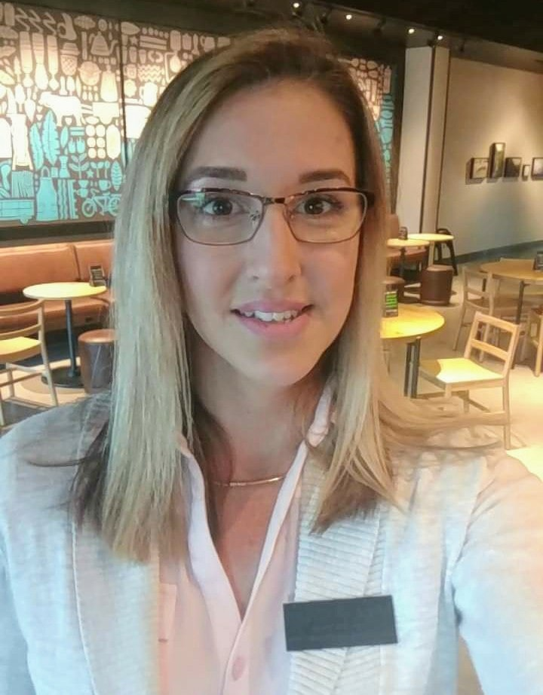
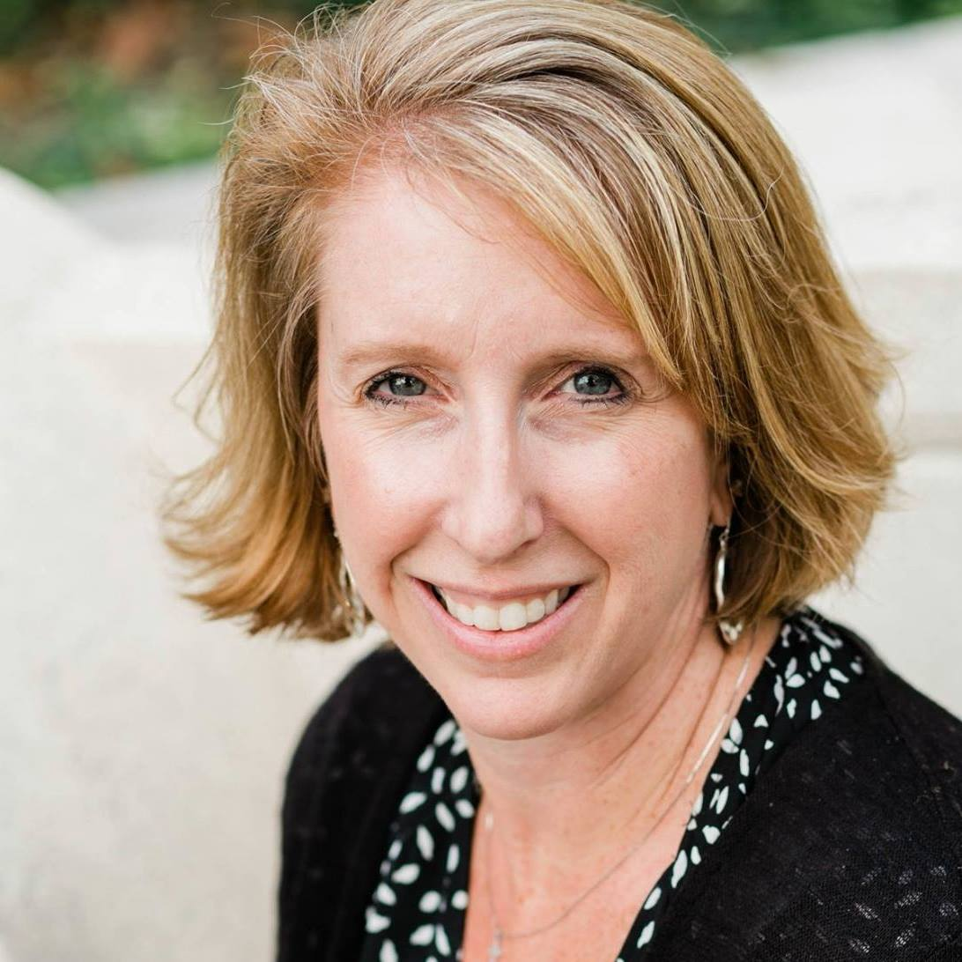
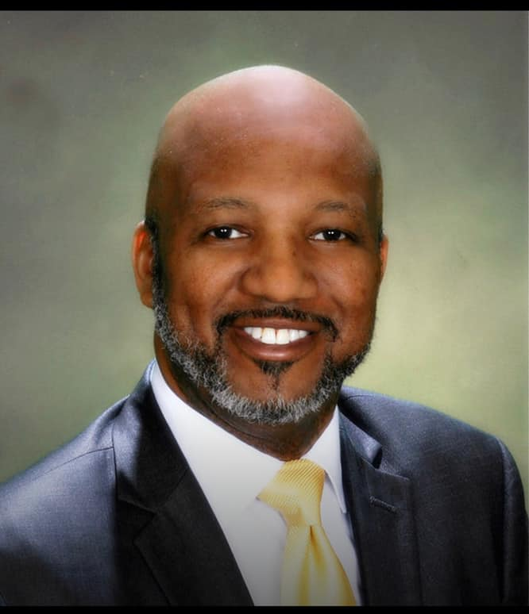
Tri-County Heartland Chapter Board Members
Barbara Stone: President
Sarah Fuentes: President Elect
Shannah Butcher: Vice President
Glenn Jones: Treasurer
Jahlinda Jones: Social Media Specialist
Destiny Crisman: Secretary

